Slide 1
Go:
The Deepest Game
Peter Drake, Lewis & Clark College

Slide 2
Overview
The game of Go
The challenge
Traditional methods
Monte Carlo tree search
Enhancements

Slide 3
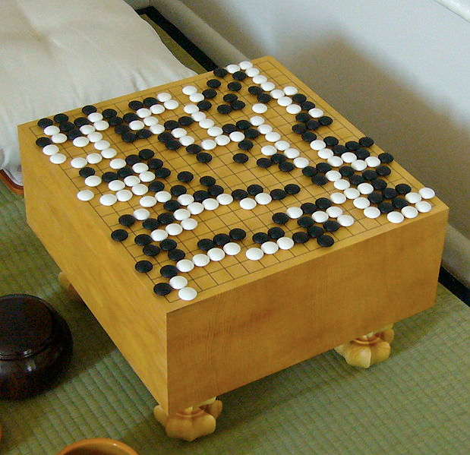
The game of Go
Notes:
The oldest strategy game in the world

Slide 4
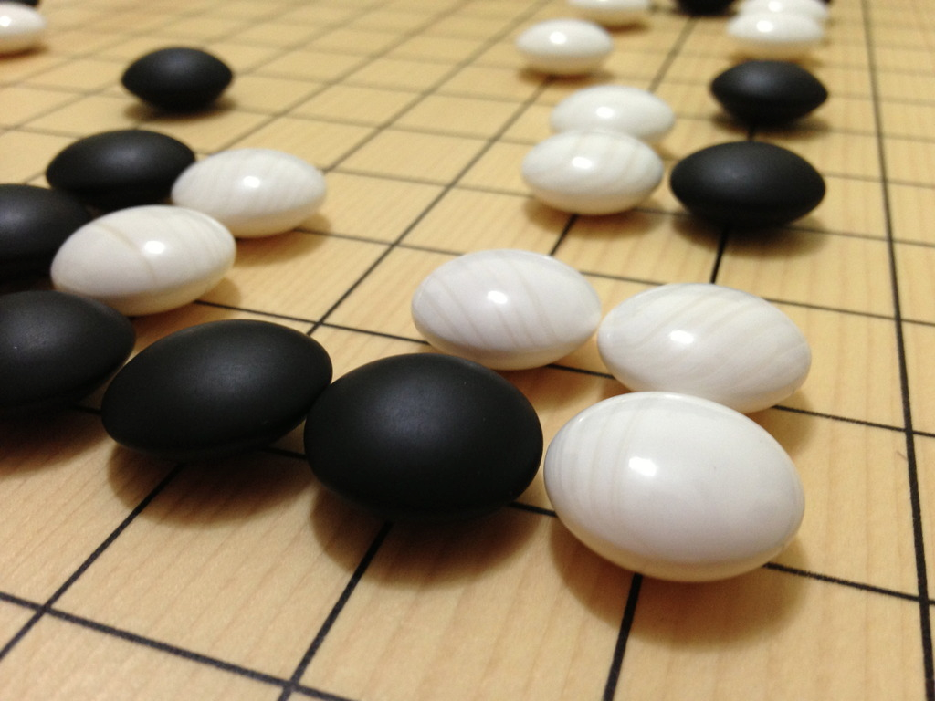
The elements
The board is initially empty
Black plays first
To play, place a stone on an intersection
Notes:
Board size can vary

Slide 5
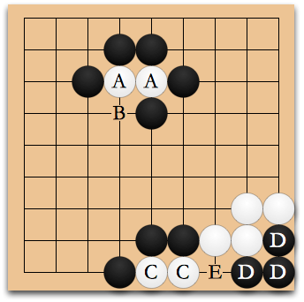
Capturing
A contiguous group of stones with no liberties is removed
Suicide is illegal, but a move that captures something is not suicide

Slide 6
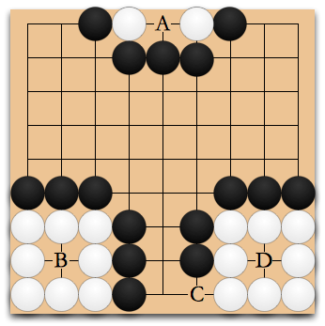
Where can black capture?

Slide 7
Play Capture Go
The first player to capture anything wins

Slide 8
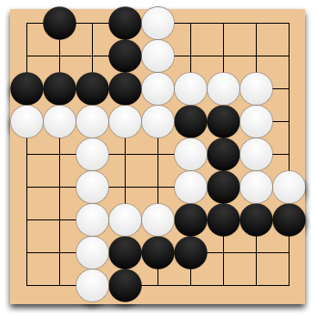
Territory
Notes:
Black has 5 + 8 = 13, white has 10 + 4 + 11 = 25
Count for white, ask audience what black has

Slide 9
Passing and scoring
You may pass (giving the opponent a prisoner) instead of placing a stone
Two consecutive passes ends the game, but white must pass last
Score is <territory> - <stones lost>

Slide 10
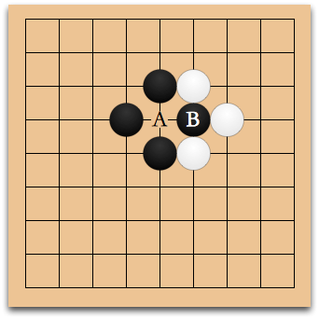
The ko rule
It is illegal to repeat a previous board state

Slide 11
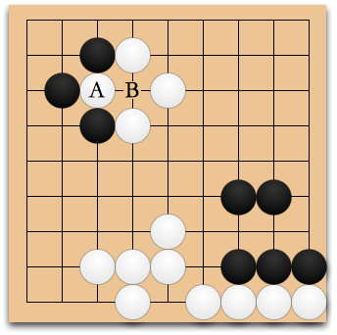
Where should black play?
Notes:
Ko threat

Slide 12
Rules summary
Black plays first
On a turn, place a stone or pass
A group with no liberties is captured and removed
Suicide is illegal
It is illegal to repeat a previous board state
Two passes ends the game
White passes last
Score = territory - stones lost
High score wins

Slide 13
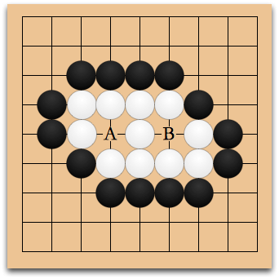
Life and death

Slide 14
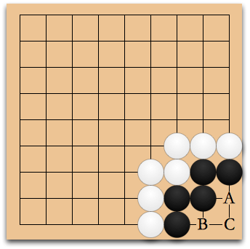
Can black live?
Notes:
What if it’s white’s turn?

Slide 15
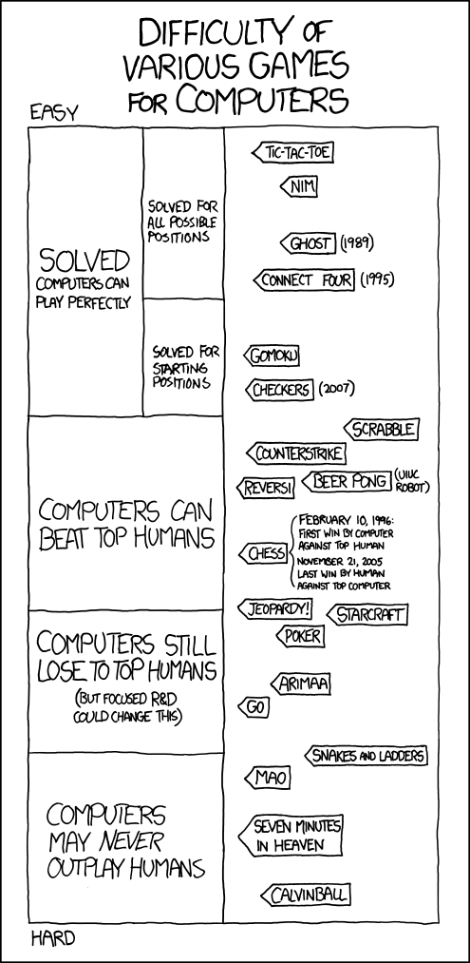
The challenge

Slide 16
Why is this so hard?
Estimating the score is difficult
The space is … vast

Slide 17
When you say “vast”...
3³⁶¹ ≅10¹⁷²
There are about 10⁸⁰ atoms in the universe.
Also, Go is PSPACE-complete.

Slide 18
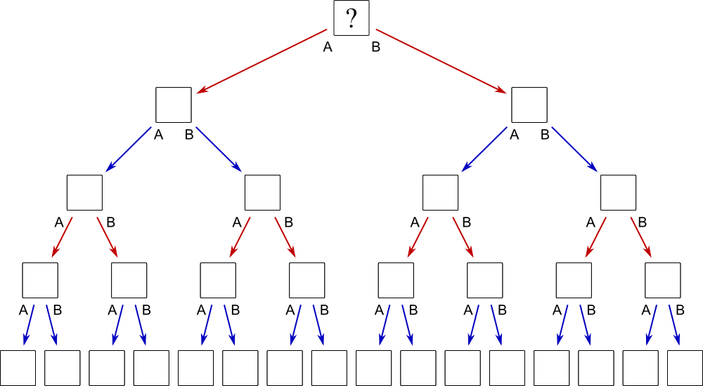
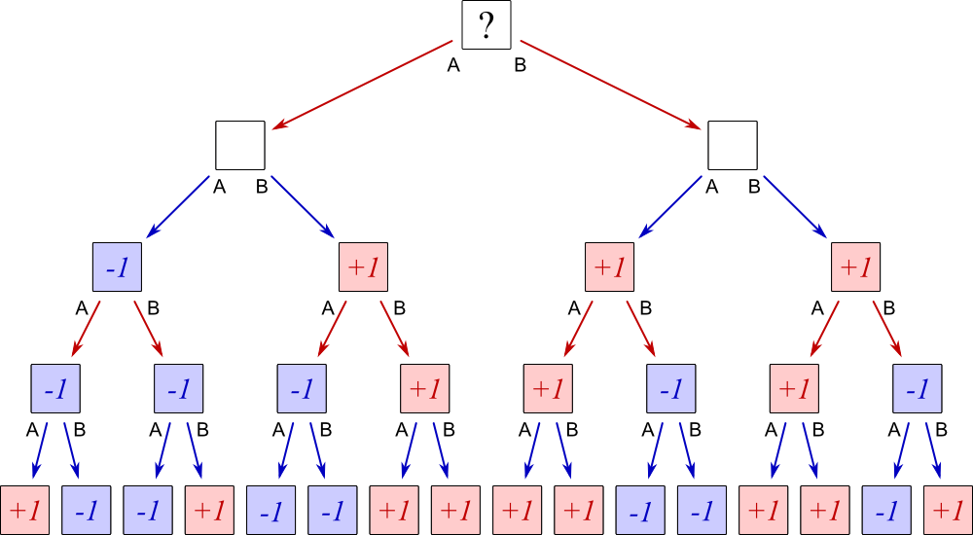
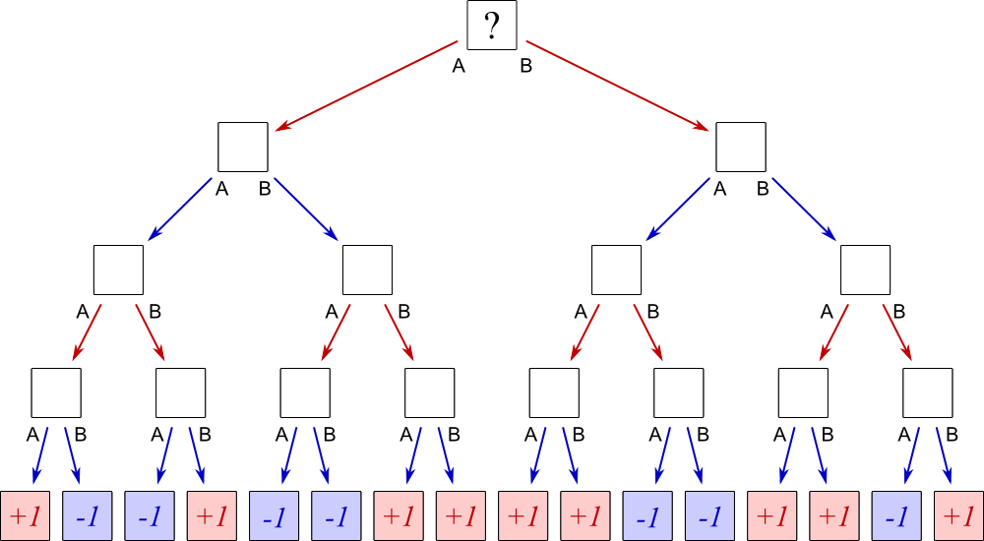
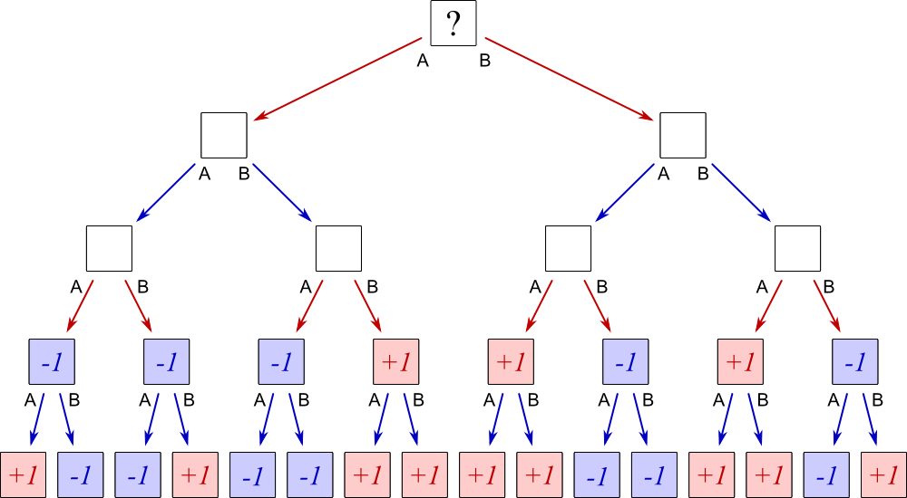
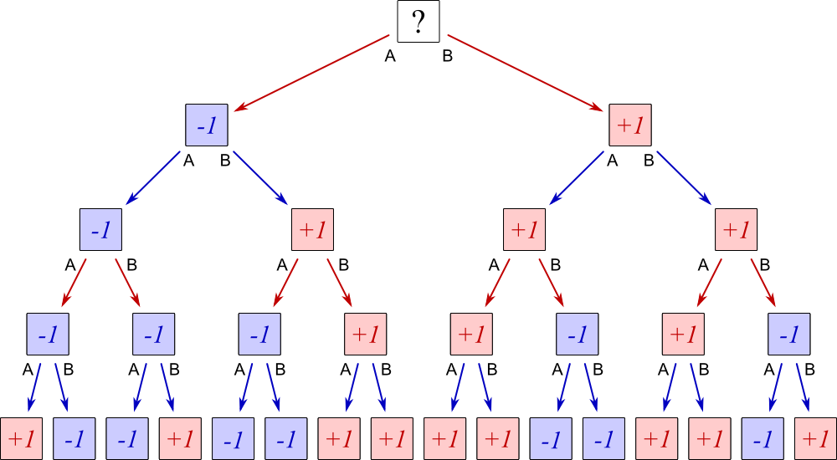
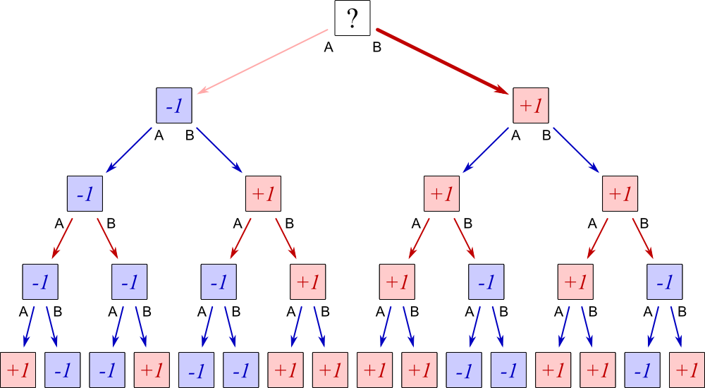
Minimax search

Slide 19
Variations on minimax
Alpha-beta pruning
Static evaluation
Move suggestion

Slide 20
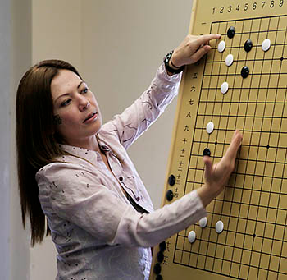
Janice Kim vs Handtalk
“Weak” professional player
25-stone handicap
Winner: human
Notes:
1997

Slide 21
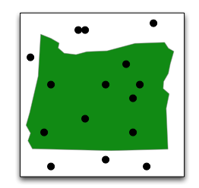
Monte Carlo methods

Slide 22
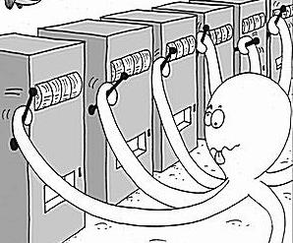
The k-armed bandit
Notes:
Exploration vs exploitation

Slide 23
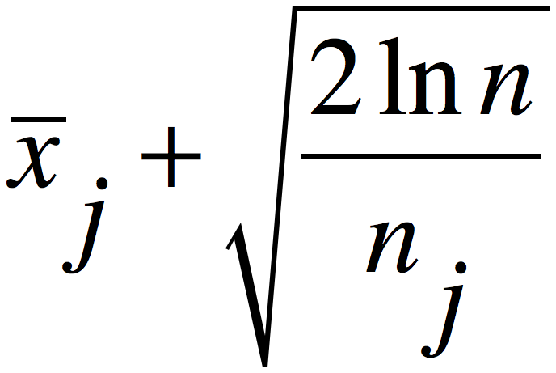
UCB: Upper Confidence Bounds
Notes:
2002

Slide 24
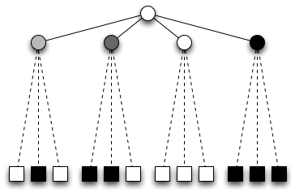
One-ply Monte Carlo search

Slide 25
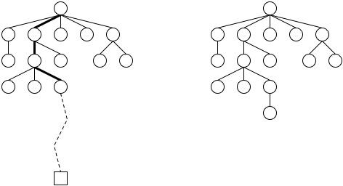
Monte Carlo tree search
Notes:
UCT, 2006, Kocsis and Szepesvári

Slide 26
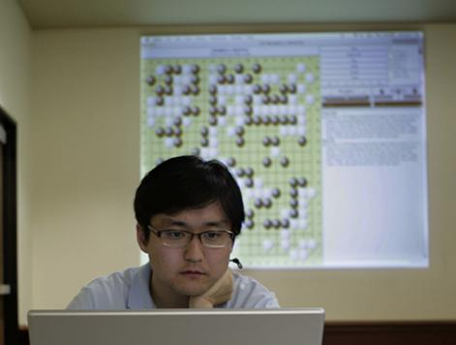
Kim Myungwan vs MoGo
Strong pro
800 processor cores
9-stone handicap
Winner: computer
Notes:
2008
Zen has since beat several 9-dan pros at 4 stones

Slide 27
Go ranks
9 dan professional (top player)
...
1 dan professional
9 dan
…
1 dan (“black belt”)
1 kyu
2 kyu
…
29 kyu
30 kyu (absolute beginner)
Notes:
Do I need this slide?

Slide 28
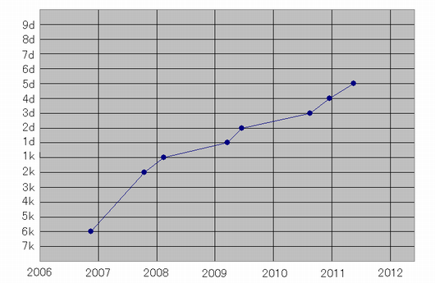
Recent history of program strength

Slide 29
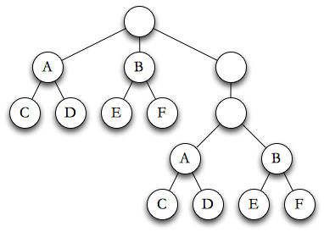
Local search
Notes:
Perhaps this is the key; foreshadows RAVE and LGR(F)

Slide 30
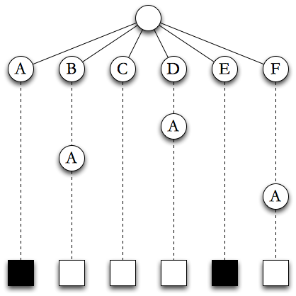
RAVE: Rapid Action Value Estimation
Notes:
Gelly and Silver, 2011

Slide 31

The last good reply
For choosing moves beyond the tree
If it worked last time, do it
Variations: 2 moves, forgetting

Slide 32
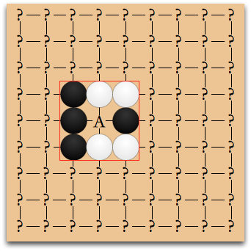
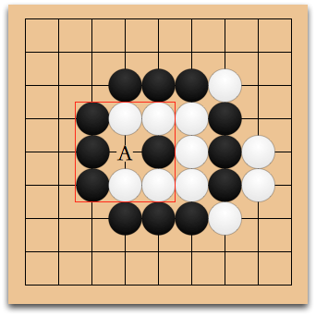
Patterns

Slide 33
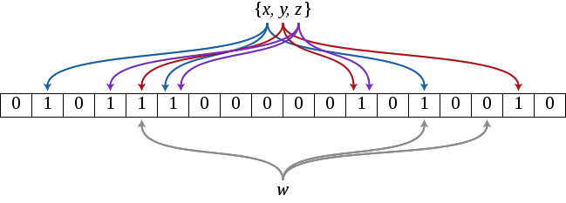
Bloom filters

Slide 34
Where to learn more
American Go Association (usgo.org)
Browne, et al., “A Survey of Monte Carlo Tree Search Methods,” IEEE Transactions on Computational Intelligence and AI in Games, vol.4, no.1, pp.1-43, March 2012
https://sites.google.com/a/lclark.edu/ drake/research/orego

Slide 35
Acknowledgments
Funding
Willamette Valley REU-RET Consortium for Mathematics Research (NSF)
John S. Rogers Science Research Program (Lewis & Clark)
Cardboard Go sets: American Go Foundation
Images
Wikipedia
BoardGameGeek
xkcd
American Go E-Journal
Microsoft Research
Adam Smith
Peter Shotwell

